Slide 1
Evidence Section
Drieam

Slide 2


Agenda
A
Introduction
Review
Possible approach
Summary

Slide 3
Introduction
At Contoso, we empower organizations to foster collaborative thinking to further drive workplace innovation. By closing the loop and leveraging agile frameworks, we help business grow organically and foster a consumer-first mindset.

Slide 4
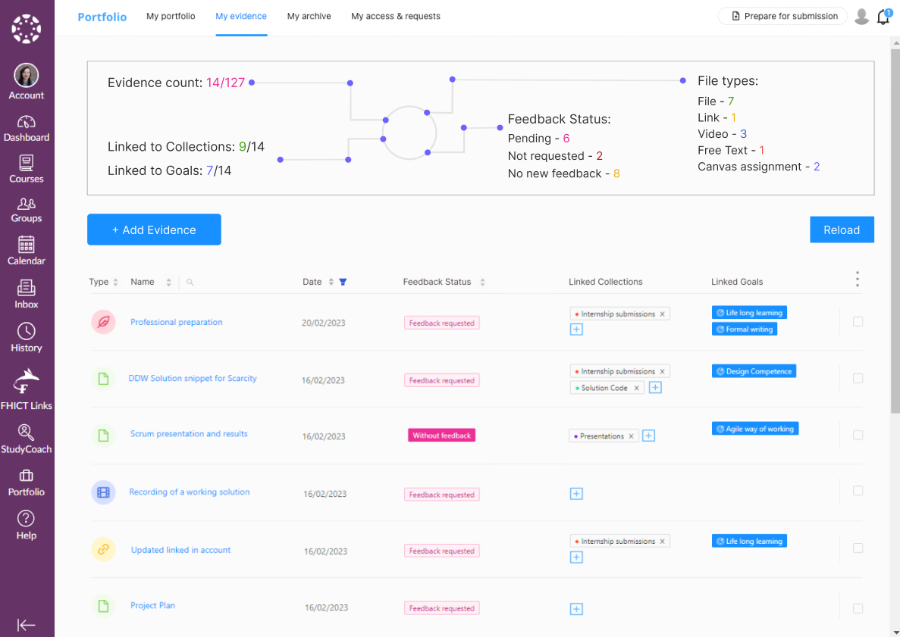

Slide 5
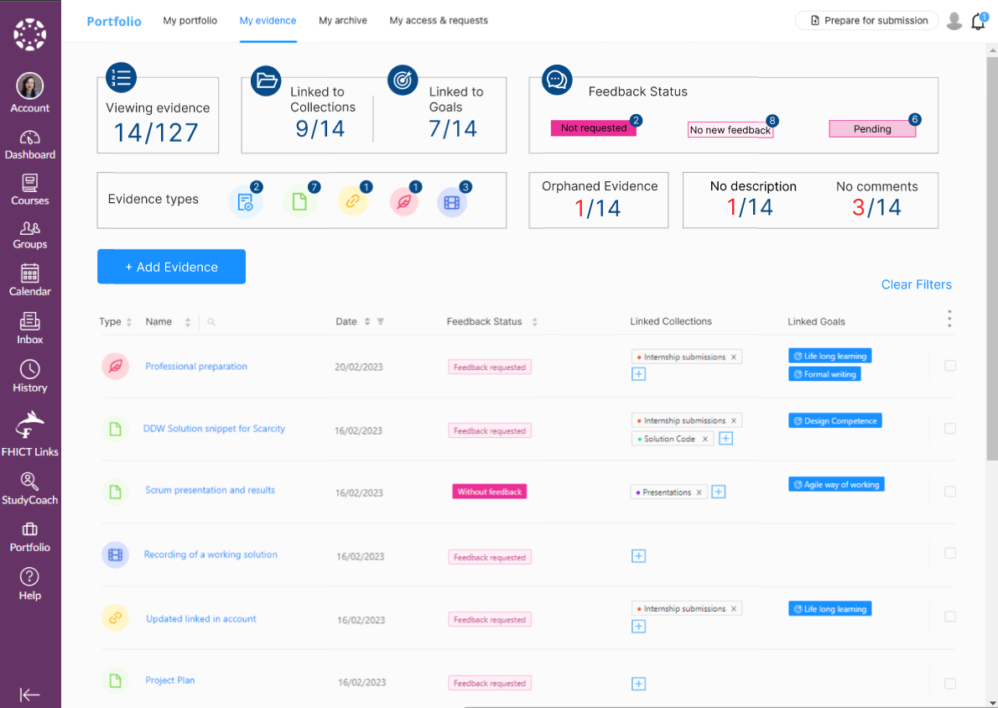

Slide 6
Plan for product launch
Deploy strategic networks with compelling e-business needs
Planning
Synergize scalable e-commerce
Marketing
Disseminate standardized metrics
Design
Coordinate e-business applications
Foster holistically superior methodologies
Launch
Strategy

Slide 7
Areas of focus
F
B2B market scenarios
Develop winning strategies to keep ahead of the competition
Capitalize on low-hanging fruit to identify a ballpark value
Visualize customer directed convergence
Cloud-based opportunities
Iterative approaches to corporate strategy
Establish a management framework from the inside

Slide 8
Summary
At Contoso, we believe in giving 110%. By using our next-generation data architecture, we help organizations virtually manage agile workflows. We thrive because of our market knowledge and great team behind our product. As our CEO says, "Efficiencies will come from proactively transforming how we do business."

Slide 9
Thank you
Edita​ Pronckute

